Slide 1
Domain #11 Capstone Project TWITTER SENTIMENT ANALYSIS
Group 33
Aditya Baskaran 2019AIML028
Aravind V 2019AIML127
Ganesh Sharma 2019AIML014
Nithesh Balakrishnan 2019AIML049
Vibha Kumar 2019AIML153

Slide 2
Acknowledgements
Thanking our Mentor, Faculty and TA for their Guidance and Help
Lead Instructor Name: Prof. Gautam Gangopadhyay
Lead Faculty: Prof. Kamlesh Tiwari
Faculty: Prof. Raja Vadhana P
Teaching Assistant Name: Kartheek Akella

Slide 3
Table of Contents
Problem statement
Objective
Background of previous work done in the chosen area
Machine Learning Process Flow
Potential Data Challenges & Risks
Detailed Plan of Work
Pre-Processing
Machine Learning Modelling & Techniques Applied
Interpretation
Future Work & Extension or Scope of improvements
Conclusions / Recommendations

Slide 4
Problem Statement
Twitter allows businesses to reach a broad audience and connect with customers without intermediaries. On the downside, there’s so much information that it’s hard for brands to quickly detect negative social mentions that could harm their business.
Listening to customers on Twitter allows companies to understand their audience, keep on top of what’s being said about their brand, and their competitors, and discover new trends in the industry.
The sentiment analysis of twitter can also be applied to analyze the political views of the people which would help in decision of the voting of the political party.
According to a study* Twitter has about 330 million monthly users
* https://en.wikipedia.org/wiki/Twitter

Slide 5
Objective
Background
Sentiment analysis is the automated process of identifying and classifying subjective information in text data.
Since sentiment analysis tools are able to sort Twitter data automatically 24/7, quickly and accurately, you can gain up-to-the-minute insights from your social mentions.
Performing Twitter sentiment analysis can help you quickly understand the tone and context of those social mentions.
Objective
Twitter sentiment analysis allows you to listen to the customers and understand what they need. By introducing sentiment analysis tools into your workflows, you can automatically organize unstructured information (which includes Twitter data) in real-time, at scale, and accurately:

Slide 6
Business Benefits
Business: In marketing field companies use it to develop their strategies, to understand customers’ feelings towards products or brand, how people respond to their campaigns or product launches and why consumers don’t buy some products.
Politics: In political field, it is used to keep track of political view, to detect consistency and inconsistency between statements and actions at the government level. It can be used to predict election results as well!
Public Actions: Sentiment analysis also is used to monitor and analyse social phenomena, for the spotting of potentially dangerous situations and determining the general mood of the blogosphere.

Slide 7
Previous Work
Domain studies on potential parameters and processes that might be causing claims to be denied
Several of these studies highlight various factors that influence claim denial/rejection
They also highlight shortcomings of rule based analytical approaches to solution
Studies around data preparation that are typical to this problem, for example, imbalanced class in data
Several Studies show how class imbalance characteristic of this kind of problem can be handled
Several Studies show how significant features can be identified to reduce dimensions
Several Studies show how to handle datasets where there are too many categorical attributes with many non-unique values characteristic of this kind of problem
Studies around ML models that are best suited for data typical to this problem, for example, models that work best with imbalanced data, more and more categorical values than numerical values
Several studies point out methods that can be more suitable for such kind of problems, e.g., Catboost which is specifically geared towards categorical features.
Several Studies compare various methods as applied to these problems
Several studies talk about modern tools like driverless AI of H2O, artificial neural networks that can be applied to get optimal results.

Slide 8

Understanding of Machine Learning( Pipeline)
Extracting Knowledge hidden in large volumes of data
Identifying potentially useful and understandable data - Which data set will give hidden pattern
KDD – Knowledge Discovery in Database/Dataset
Target
Connectedness
Wisdom
Prescriptive
Analysis
What Should be done
KDD Analysis
Understanding
Principles
Knowledge
KDD & Data Mining Analysis
Predictive
Analysis
What could happen
Understanding
Pattern
Information
KDD Analysis
Descriptive
Analysis
What has happened
Understanding
Relations
Data
Understanding
8

Slide 9
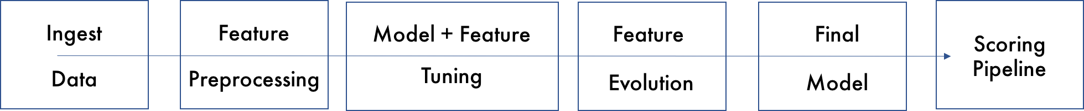
ML Steps
ML Steps
Apply Model
Monitoring
9
Data Preparation
Mode Refresh
Classify Claims
Business
Objectives
Model
Deployment
Drive Initiative
1
8
ML Objectives
7
Build Model
2
Build Model
Calculate Score
3
Data Availability
Validate Model
Data
Modeling
6
4
Data Cleansing
5
Data Transformation

Slide 10
Detailed Plan of work
Problem statement and Business Benefit – detailed discussion
Understanding columns and rows of given input transaction data
Some basic Analysis of given input data using excel pivot
Review and clarification of questions Python and Jupiter notebook installation and environment setup
Processing tweet text data
Removing ‘@’,numbers, urls, single and special characters
Tokenizing
Lemmatization
Stemming
Vectorization using TF-IDF
Week 01
Week 03
Week 07
Week 05
Week 02
Week 04
Week 06
Week 08
Data Cleaning and Pre-Processing
Read base data excel,label column creation
Check duplicate rows, missing values
Drop irrelevant columns, rows
Adddind derived feature
Tweet source distribution
Label id distribution
Conversion of label to numeric
Explore country wise data and negative tweet
Explore wordcloud of each class

Slide 11
Project Resources
Sr No | Phase | Resource Type | Resource | Versions if Applicable
1 | All | People | Mentor, Faculty, TA
2 | All | Hardware | Runtime on Google Colab Google Drive
3 | All | Software | Jupyter Notebook Anaconda Python | python:3.6.9 [GCC 8.4.0] scipy:1.4.1 numpy:1.18.4 pandas:1.0.3 re:2.2.1 nltk:3.5
4 | Collaboration | Software | Google Meet GitHub
5 | All | Laptops | 16GB RAM, Windows 10, Intel Core i7

Slide 12
Potential Data Challenges and Risks
Sr No | Data Challenge/Risk | Description | Mitigation
1 | Input history data size was huge (116 MB) | Due to very high size of historical data, our local machine had difficulties to pre and post process | This data challenge was mitigated using Google Colab for executing whole project
2 | Limited domain knowledge | Due to limited domain knowledge decision taken to keep/ drop/ process/ merge/ various attributes | This Risk was mitigated using inputs from Coordinator/ client.
3 | Imbalanced label | Distribution of Label was imbalanced. Accepted to Denial ratio was 99.6/ 0.4 | Techniques such as SMOTE, Random Over Sampler, Random Under Sampling are used
4 | Too many categories in features like Procedure code, Service Code, Diagnosis Code, Revenue Code | Too many categories in these fields and many blanks in procedure code. Treatments done on members do not require any procedure to be undertaken, but deleting the rows that have null values for the Procedure Code is not advisable as the Claims without Procedure Code do have Label of 0 and 1. | Project Sponsor provided the grouping rules and we applied them.
5 | Lot of Categorical Features | There are almost 10 categorical features in the dataset. | Applied methods like Catboost that are more suited to such dataset
6 | Numerical values has outliers and high variances | Numerical data consisting of amounts were in very high degree of range. | Drop outliers and keep range of values in a standard of range using techniques such as MinMax Scaler
7 | Garbage/ Bad Data | There are rows with blank Claim number, there are rows with denial reason codes specified against accepted claims, and there are rows with whitespaces in many columns. | Deleted rows with blank Claim Number Deleted duplicate claim number + Claim line number combination, Replaced whitespaces with Null value.

Slide 13
Preprocessing: Data Cleaning and pre-processing
Read base data excel – this data has no Label (class)
Label column creation
Check duplicate rows , check columns having constant value
Check missing values in each column and imputation if required.
Delete rows which are nor relevant
Drop columns which are nor relevant
Add derived features
Tweet_source distribution
Label id distribution
Convert label to numeric
Explore Negative tweet and its category
Country wise positive, Negative and Neutral
WordCloud of each positive, negative and neutral class
Save first round cleaned data

Slide 14
Preprocessing: Processing tweet text data
Removing user handles starting with @
Removing numbers and special characters
Removing urls
Removing single characters
Tokenizing
Removing stopwords
Expanding not words
Lemmatizing the words
Stemming the words
WordCloud of each positive, negative and neutral class with clean tweet
Save cleaned data
Vectorization using TF-IDF - Term frequency and Inverse Document frequency
Apply a machine learning model(Random forest) to check current accuracy

Slide 15
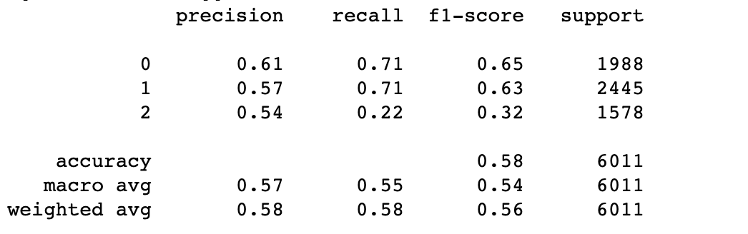
Machine Learning Basic Modeling using Random Forest
Preparation
Columns required for Text Processing
Setting the class column as the category for classification
Setting the features and labels array from the data frame
Vectoriztion using TF-IDF - Converting the Text to numbers
Apply Models
RandomForest
Find Model Summary
Sample Results with Random Forest

